Slide 1


Servicetopia
Presented By: Jason Young

Slide 2


Servicetopia

Slide 3

SERVICETOPIA
High Service Focus
High Service Focus
Low Fulfilment
High Fulfilment
Low Service Focus
Low Service Focus
Low Fulfilment
High Fulfilment

Slide 4

Performance
What Drives Servicetopia?
Teamwork

Slide 5


RELATIONAL
COORDINATION

Slide 6


Performance
People Tension
Relational Coordination

Slide 7


Relational Coordination
What you show the outside world, your talents, gifts and preferences.
What‘s underneath, the mistakes you have made and the skills that are less developed. Things that you do not feel comfortable showing the outside world.

Slide 8

Appreciating Differences
Analyze
GATHER & DECIDE
“Gut” Reaction
“Whatever”
WORK STYLE
Routine
Just Do It
DETAILS
High Attention
ENERGY
Internal
External

Slide 9
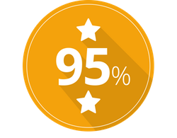
Performance
People Tension
Relational Coordination

Slide 10
Performance
What Drives Servicetopia?
Teamwork
Culture

Slide 11


Slide 12

Startup
Growth
Maturity
Learn
Change
Change Culture
Risk-Taking
Growth Culture
Building
Recruiting
Managing
Culture Cycles
Innovation Culture
Heated Competition
New products?
New strategy?
What’s next?
Learning Culture
Don’t lose your edge!
Learn your way to the next level?
Startup Culture
Risk-Taking

Slide 13

PEOPLE
CULTURE

Slide 14
Performance
Values
What Drives Servicetopia?
Teamwork
Culture

Slide 15

Purpose
Passion
Servicetopia Values
Professionalism
Process
Pizazz

Slide 16

Purpose

Slide 17


Slide 18
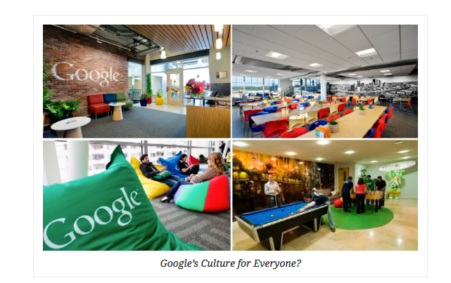

Slide 19
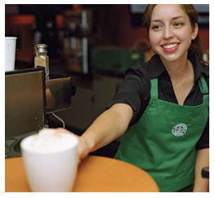
Starbucks
Features of Starbucks Coffee’s Organizational Culture
Servant Leadership (“employees first”)
Relationship-driven approach
Collaboration and communication
Openness
Inclusion and diversity
Starbucks Coffee’s culture is a key success factor in the business. The company uses its organizational culture as a distinction from competitors.

Slide 20
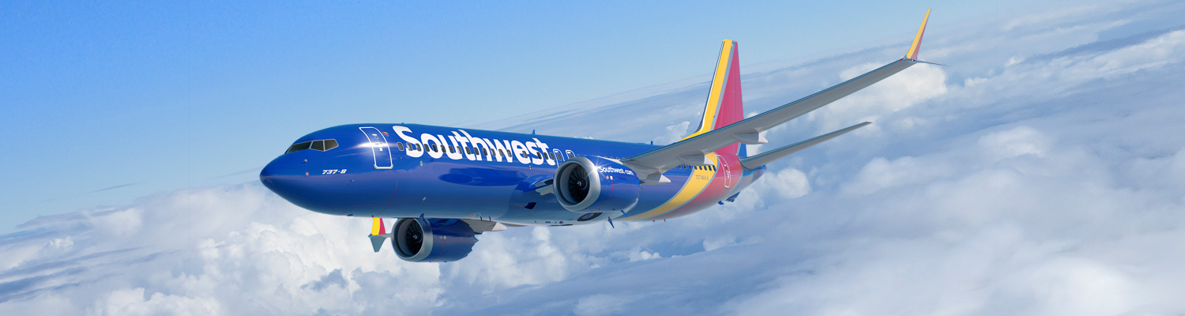
Southwest Airlines Vision
The Vision
of Southwest Airlines
The Purpose
of Southwest Airlines
The Mission
… is dedication to the highest quality of Customer Service delivered with a sense of warmth, friendliness, individual pride, and Company Spirit.
To become the world’s most loved, most flown, and most profitable airline.
Connect people to what’s important in their lives through friendly, reliable and low-cost air travel.

Slide 21

Customer Service Focus
Southwest Airlines is a customer service company that happens to be in the transportation business.
The level of service you give externally will only be as good as the level you give internally.

Slide 22

Passion

Slide 23
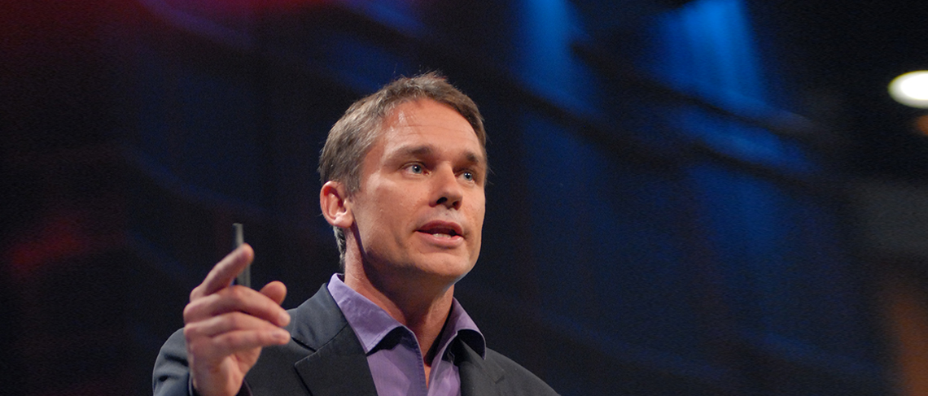
Employee Engagement
Research by Marcus Buckingham
19%
55%
26%
PASSION
Desired Behavior

Slide 24

The “CASH” Model
Real Influence
C
A
Competencies
S
Attitudes
H
Strengths
Habits

Slide 25


“
Soar with your Strengths
”
By Don Clifton
90 wpm
300 wpm
6 week
speed reading course
130
wpm
1500
wpm
$
$
$

Slide 26

Professionalism

Slide 27

01
Appearance
02
Facial Expression
What People Notice
03
Eye Contact
“The 4 Minute Sell”
Research by Janet Elsea
04
Body Movement
05
Personal Space
06
Touch

Slide 28

Sending & Receiving Emotions
Gestures
55%
Tone
38%
Albert Mehrabian
Professor Emeritus of Psychology, UCLA
Words
7%

Slide 29

Process

Slide 30


The Power of Process
Establish a process for:
Setting clear service standards.
Empowering employees to make customer service decisions.
Providing continuous customer service training.
Rewarding excellent service behaviors.
Resolving conflict and providing effective feedback.

Slide 31


Thomas/Kilmann Conflict Principles
You cannot NOT deal with Conflict.
There’s no “Right Way” to deal with Conflict
Conflict is inevitable.
Conflict is neutral.

Slide 32
High
Thomas/Kilmann Conflict Model
Competing
Collaborating
Assertiveness
Compromising
Avoiding (3-D’s)
Accommodating
Cooperativeness
Low
High

Slide 33

B
Behavioral Description
The “BEST” Feedback Model
E
Express Your Feelings
S
Solicit Input
T
Talk About Expectations

Slide 34

Pizazz

Slide 35


Slide 36


THE
MOMENT
OF TRUTH

Slide 37
Moments of Truth
Perception
Behaviors
Intentions
Values

Slide 38
Listen
Silent

Slide 39


Slide 40

Accountability
Responsibility
0%
100%
Empowerment/Influence
0%
100%
Victim/Blame

Slide 41

Victim Mentality at Work

Slide 42
Accountability
Responsibility
0%
100%
Empowerment/Influence
0%
100%
Victim/Blame
Owner/Control
Freedom/Success

Slide 43
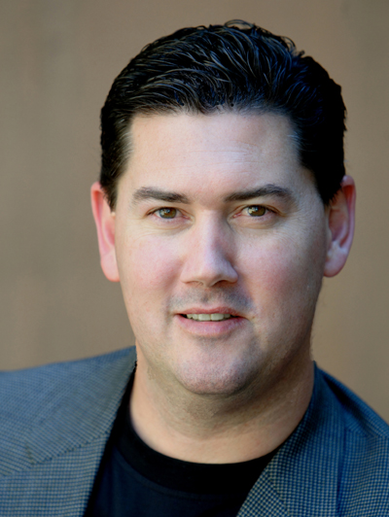
Thank You
Connect with Jason Young
Phone : (972) 965-9205
Email : jason@culturetopia.com
Web : www.culturetopia.com
Twitter : @Culturetopia

Slide 44
Thank You!

