Slide 1


Leveraging the New Demographics & Macro Trends
Presented By: Kelly McDonald, McDonald Marketing

Slide 2
TREND #1: DIVERSITY – A TREND, NOT A FAD

Slide 3
CLEAR TREND: THE CENSUS DIVERSITY INDEX
The probability that two people chosen at random would be of a different race and ethnicity on a 0-100 scale. The scale ranges from 0 (no diversity) to 100
34
47
52
61

Slide 4
Top 5 Most & Least Diverse States
Most Diverse States:
Hawaii 76
California 70
Nevada 68
Texas 67
New York 65
Least Diverse States:
Maine 19
Vermont 20
West Virginia 20
New Hampshire 24
Montana 30
Source: Census 2020

Slide 5
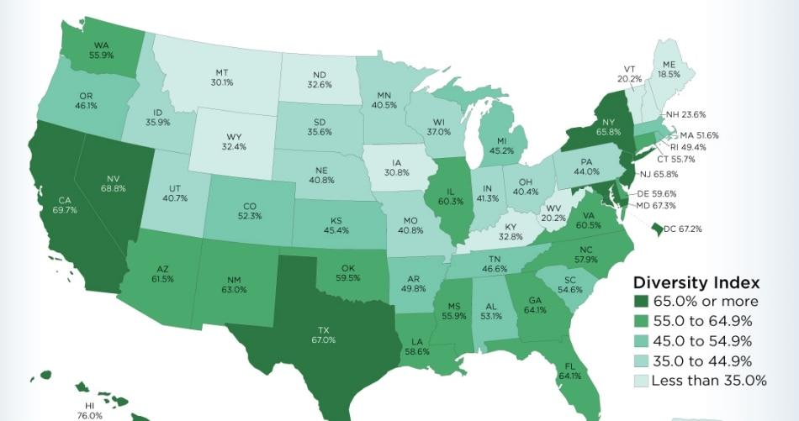

Slide 6


1 in 6 MARRIAGES IS TO A SPOUSE OF DIFFERENT RACE OR ETHNICITY

Slide 7



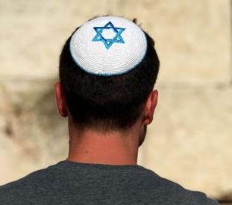


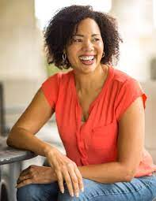


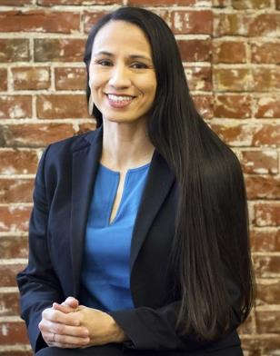
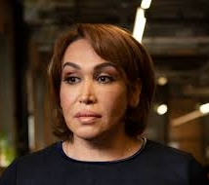


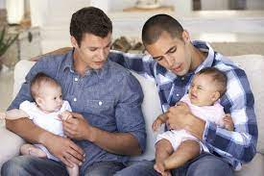

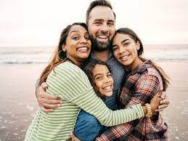


DIVERSITY COMES IN MANY FORMS

Slide 8


A Few Ways You Might Not Have Thought of as “Diversity”
Introverts vs. Extroverts
Creative vs. Analytic Thinking
Morning People vs. Night Owls
Generational differences & perceptions of “good service”
Rural vs. Metro
Communication styles: face-to-face or email/texting only
Apple people vs. Google people

Slide 9

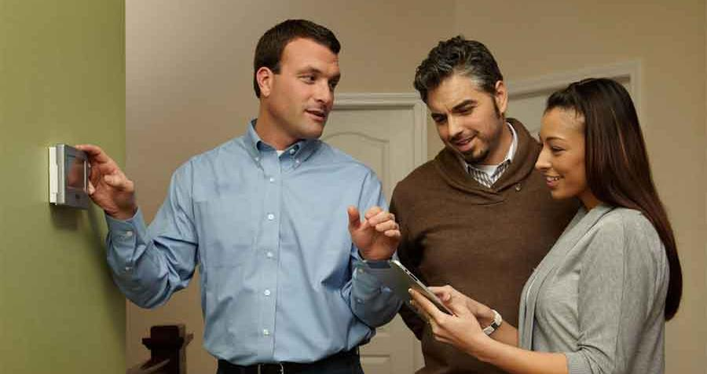
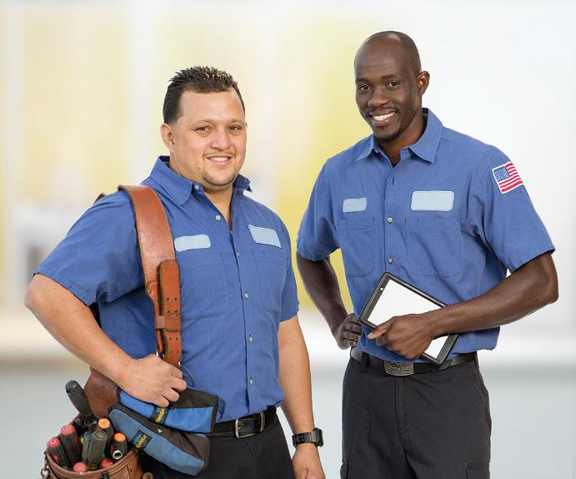
HOW TO LEVERAGE THIS TREND
Use diverse imagery
in your marketing

Slide 10
TREND #2:
RURAL SHIFTS & THE SUBURBURBAN SNAPSHOT

Slide 11

Rural to Urban Shift:
3 of 4 Live in Urban Counties
In 2000, 17.3% lived in rural counties
By 2010, that dropped to 16.4%
As of 2020, just 12%
Rural Midwest lost most
  Agricultural areas and jobs increasingly mechanized

Slide 12
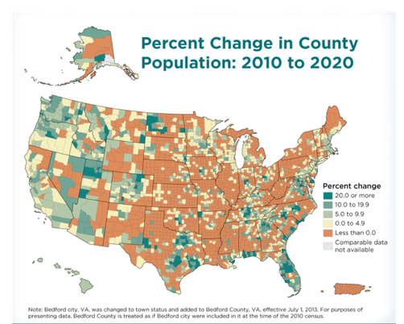

Slide 13
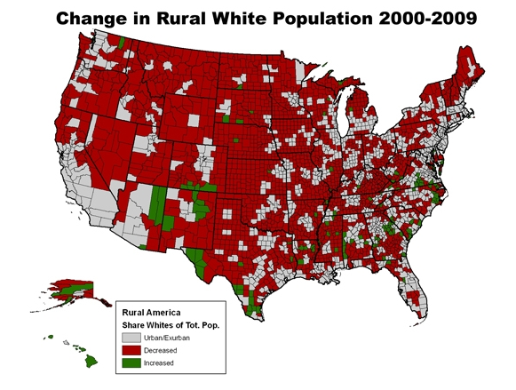
Change in White Rural Population

Slide 14
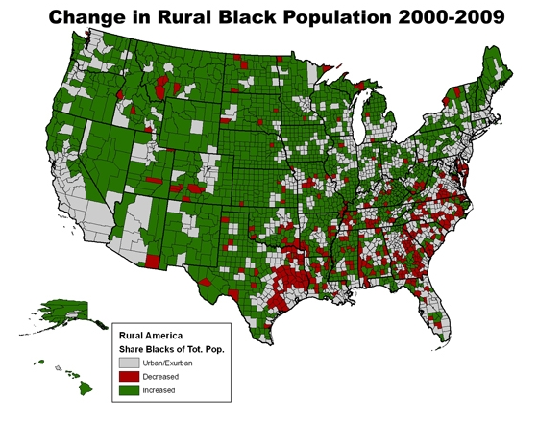
Change in Rural Black Population

Slide 15
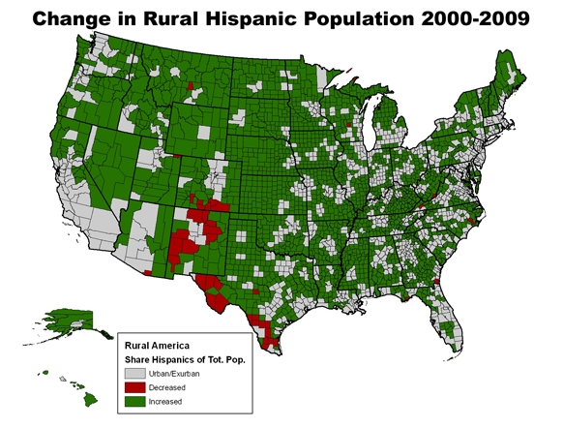
Change in Rural Hispanic Population

Slide 16

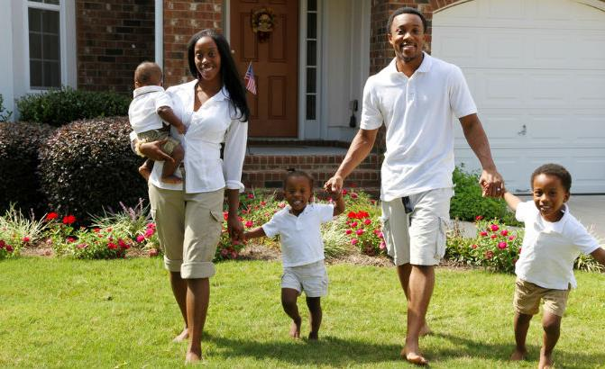
MINORITIES MOVING TO SUBURBS
Suburbs still tend to be majority White
However, for the 1st time, a majority of all racial and ethnic groups in large metro areas live outside the city

Slide 17
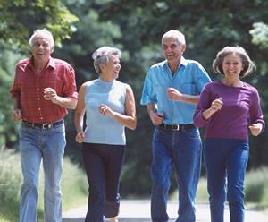


OTHER SUBURBANITES
Vast majority of Baby Boomers
Fastest-growing in the suburbs:
  People living alone
  Non-married couples & families

Slide 18
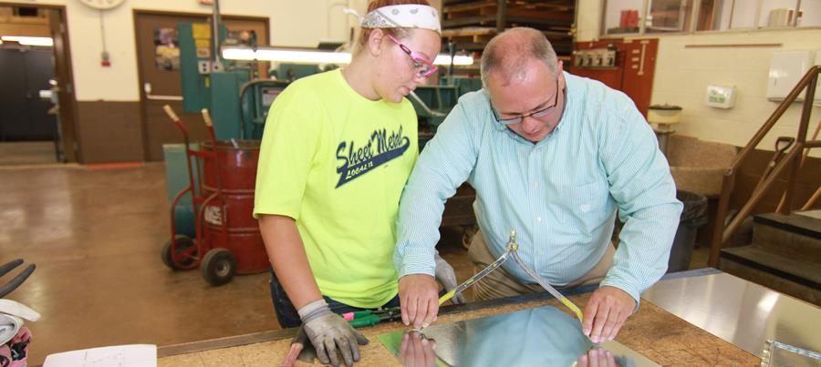

HOW TO LEVERAGE THIS TREND
If you’re in a rural area, expand your recruiting and marketing efforts to reach more diverse communities

Slide 19
TREND #3: CONSUMER INSIGHTS DRIVE EFFECTIVE MARKETING & CUSTOMER EXPERIENCE

Slide 20
Understanding Someone Different from You Means Understanding Their Life
Their priorities
Their values
The experiences that define them
Their perspective

Slide 21
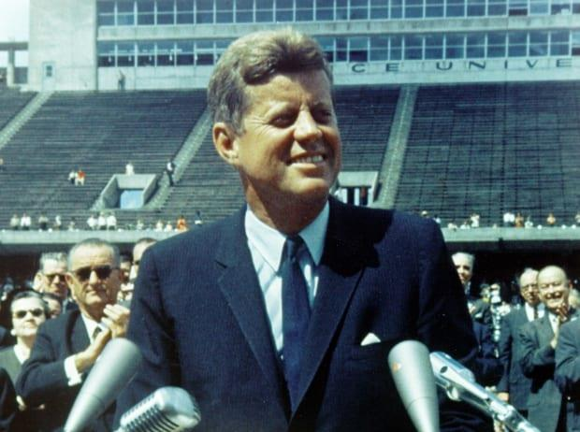

Try This Exercise!
When asked to name how Kennedy died…
Matures & Boomers
  Gunshot wound in Dallas
Gen X
  Plane crash near Martha’s Vineyard

Slide 22

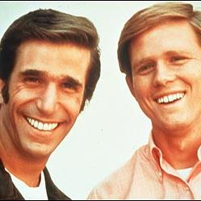
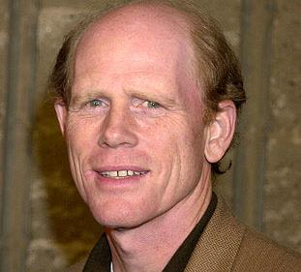
Who is Ron Howard?
Matures
Boomers
Gen X & Gen Y

Slide 23


Women Value the Opinions of Others
Women want testimonials/customer reviews online
Women trust what other women say

Slide 24
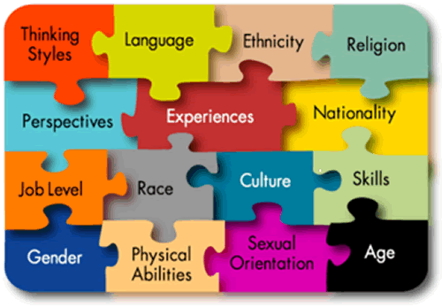

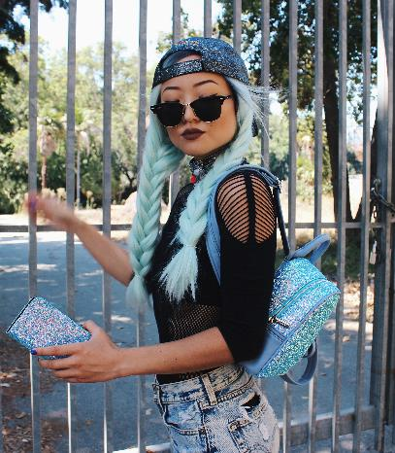
Millennial’s Key Values
Diversity is expected
Self expression is encouraged
Customization / personalization

Slide 25




MILLENNIALS PREFER PETS OVER PEOPLE

Slide 26
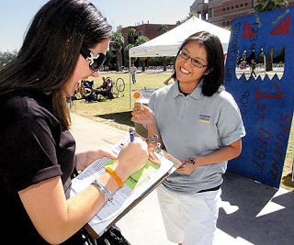



THEY’D RATHER JOIN A CAUSE THAN A CLUB

Slide 27
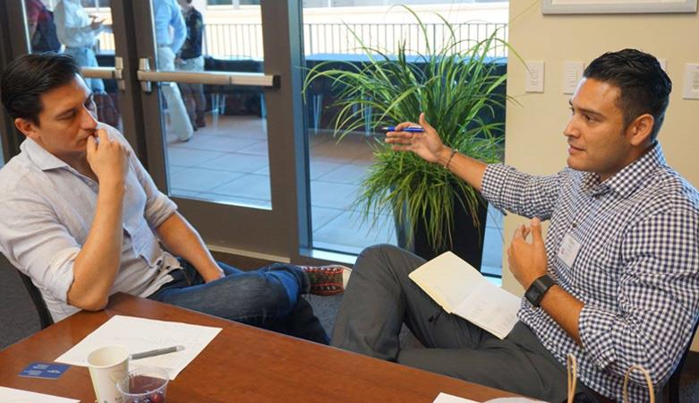


Hispanic / Latinx Insights
Relationships, Not Transactions
Great customer service and strong relationships overcome mistakes

Slide 28

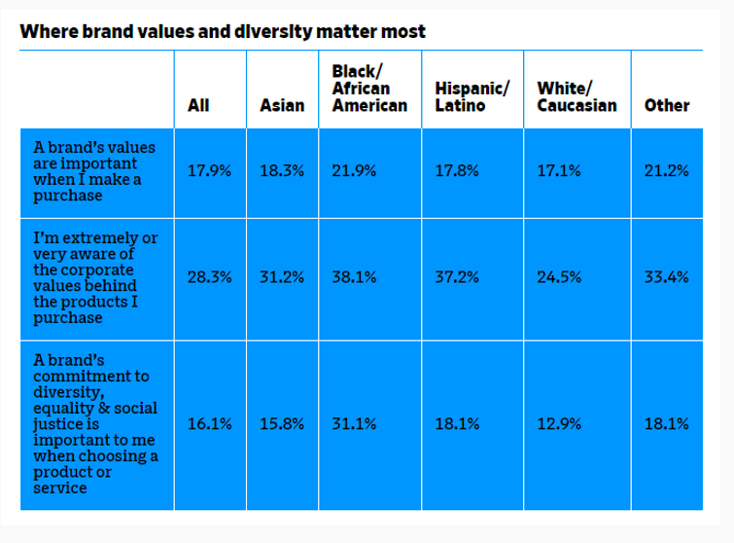

Black Customers are Group Most Swayed by Brand Values & Diversity Practices
Numerator study, Jan 2021

Slide 29

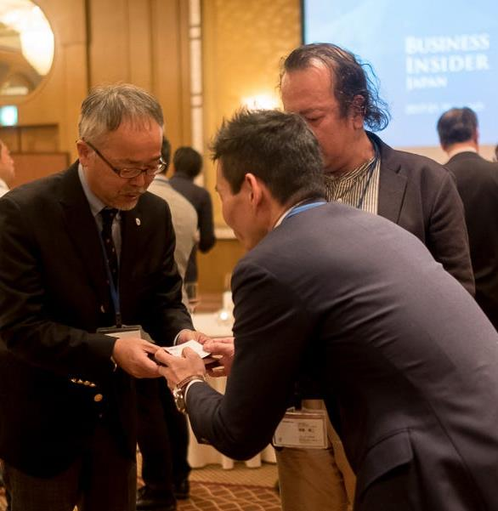
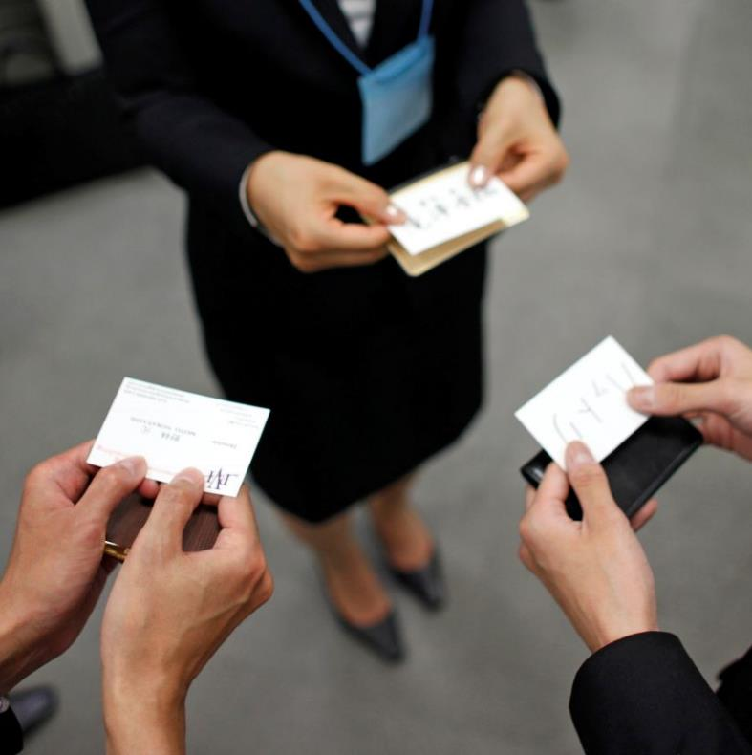

Asian
Values & Insights
Respect is paramount
Diplomacy always

Slide 30


Southeast Asians
Value and Affordability – and Total Cost
Transparency
  About fees, extra charges, hurdles & delays

Slide 31

Selling to Southeast Asians
Promote that your company is legally sound
Heritage:
  “Been in business for 35 years”
Promote any awards or accolades you’ve earned

Slide 32

Most Global Cultures: “Three Cups of Tea”
The first cup is shared as strangers
The second cup is shared as friends
The third cup is shared as family

Slide 33
HOW TO LEVERAGE THESE INSIGHTS
Tailor your marketing and sales approach to reflect different cultures
Be patient with the speed of doing business with those from other cultures. Remember “3 cups of tea”.
Post testimonials on your site, especially if you have happy, satisfied women customers
Include images of pets – people LOVE pictures of pets

Slide 34
TREND #4: UNIVERSAL VALUES EMERGE

Slide 35

GREEN MATTERS
50% of U.S. homeowners say they want more green choices
37% are more likely to pay attention to brands that are committed to the environment or environmental causes

Slide 36

Every Business is a
Local Business

Slide 37


FASTER IS BETTER AND SIMPLE IS AWESOME
Fast, simple, easy, clear, not clunky
Not DIY - it’s now DIM
Do It Myself

Slide 38

Talk Straight & Be Honest
Even when it’s hard
Use simple language

Slide 39

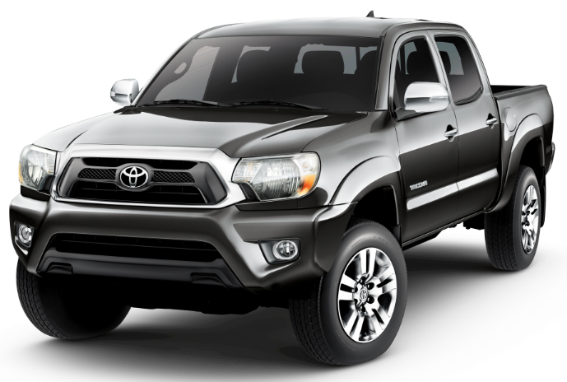
TOYOTA CREATED MUTUAL STRATEGY WITH THEIR DEALERS
Trucks are top sellers and high gross profit vehicles
Toyota needed truck volume
Dealer meetings:
  “We can’t hit our sales numbers unless we hit our truck numbers”

Slide 40
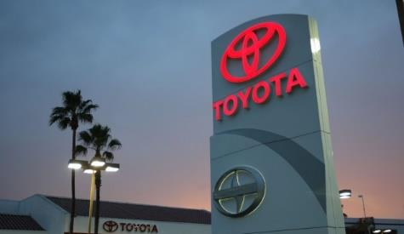
Toyota Kept it Simple…
They asked:
  “What do you need from us to help you sell more trucks?”
Dealers answered:
  More product training
  More inventory on popularly equipped vehicles
  Enhanced advertising/marketing funds
  Salesperson incentives
  Special promotions

Slide 41
HOW TO LEVERAGE THIS TREND
Tout that you are:
Easy to do business with – and why
A local business, employing local people, part of the local community
Environmentally responsible (even if its just recycling paper at the office)
Straightforward and truthful

Slide 42
TREND #5: BE THE GOOD GUYS

Slide 43

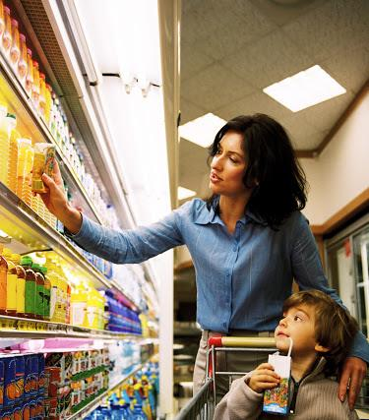
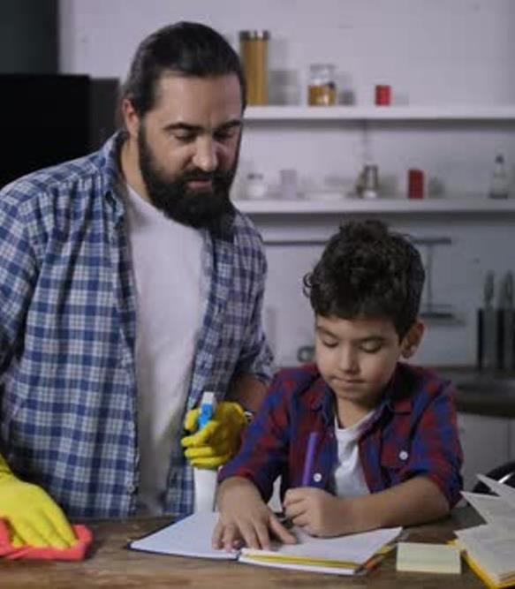


More Single Parents than Ever Before
  Anything that helps them or saves time is WONDERFUL

Slide 44
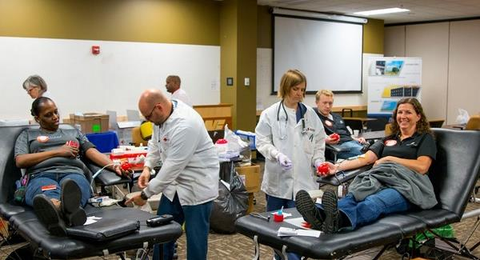


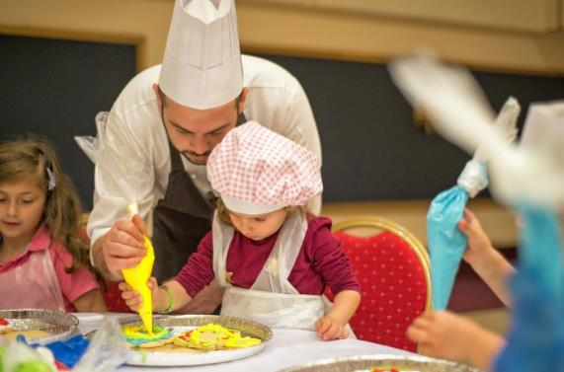

SHOW YOUR SOUL

Slide 45
HOW TO LEVERAGE THIS TREND
Let viewers know the causes and organizations you support. Create a tab on your site’s homepage that touts “Community Involvement” or “How We Help”
Add pictures of your team working with local events
To reach single parents, include a section titled “Making it Easy for Every Kind of Family”, with info on how you understand the demands of working parents and single parents and what you do to make your service and installation as smooth and easy as possible

Slide 46
TREND #6: GIVE PEOPLE WHAT THEY WANT

Slide 47


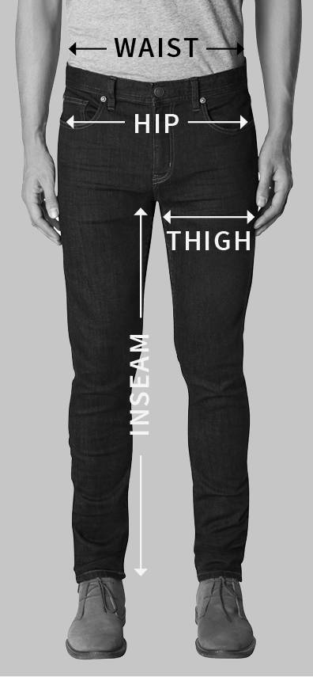
MACY’S PRODUCTS DIFFER BY REGION
SALT LAKE CITY
ATLANTA
SEATTLE

Slide 48
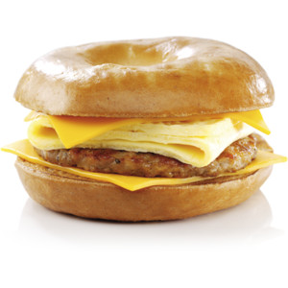
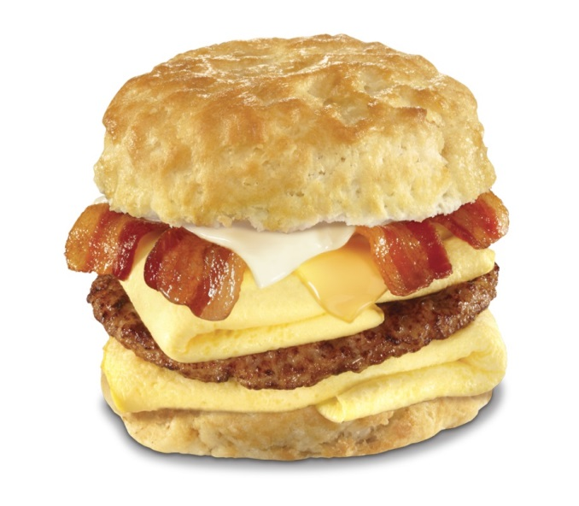
BURGER KING ADJUSTS ITS MENU
BIRMINGHAM
NEW YORK CITY

Slide 49
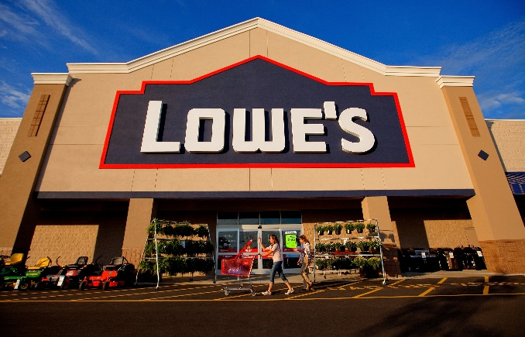

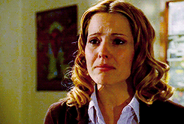
Be Aware that Our Differences are Real
Scott – retail executive
Sally’s Beauty Supply

Slide 50

WHAT SCOTT DID…
“Talk to me. Tell me what’s going on and how I can help.”
  Dialogue (talk to me)
  Barriers (what’s going on?)
  Solutions (how can I help?)

Slide 51

SELLING TO WOMEN
Value expansive choices, seeing all options

Slide 52
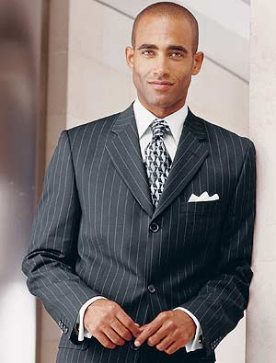
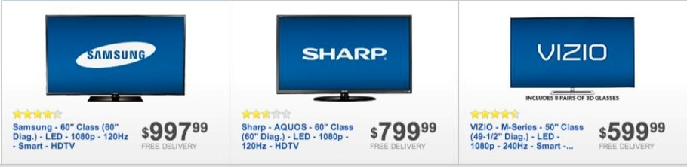


SELLING TO MEN
Want choices simplified
The “magic number” is 3

Slide 53

WHAT NO ONE WANTS…
“Information that makes me feel stupid”

Slide 54

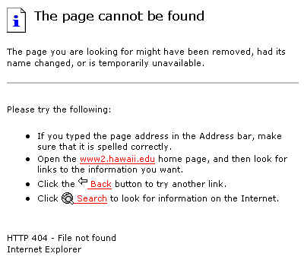

EVERYONE’S
#1 PET PEEVE
TECHNOLOGY THAT DOESN’T WORK
Check your site for broken links

Slide 55
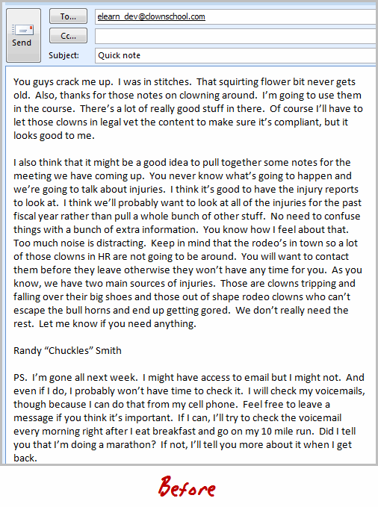
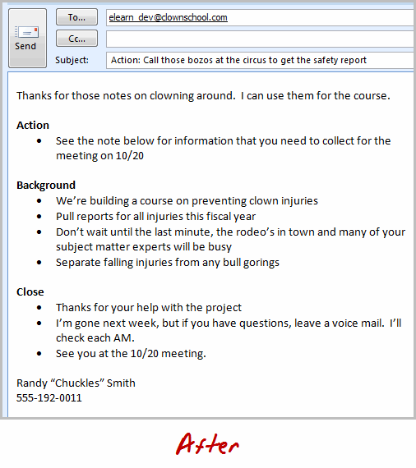

No One Reads Anymore – We Skim…

Slide 56
HOW TO LEVERAGE THESE TRENDS
Keep
Keep your emails short. Use bullet points and white space.
Avoid
Avoid using industry jargon when talking with customers.
Give
Give women all the info and options. With men, narrow to “Here are the three best options” or “My three recommendations are…”
Review
Once a quarter, review your entire website for broken links

Slide 57
TREND #7: SOLUTIONS, NOT EXCUSES

Slide 58

“We’ll take care of it”

Slide 59
TREND #8: HELPING BEATS SELLING

Slide 60

HELPING BEATS SELLING
If you help me, you’ll sell me.
And if you help me, you don’t have to sell me.

Slide 61

Your Turn
Turn to your neighbor and discuss one thing you learned here today that you can go back and utilize or apply right away

Slide 62
FIVE THINGS YOU CAN
DO RIGHT NOW

Slide 63
5 THINGS TO DO – AND REMEMBER
USE DIVERSE IMAGERY IN YOUR MARKETING – PEOPLE WANT TO SEE IMAGES THEY CAN RELATE TO
REMEMBER THATFASTER IS BETTER AND SIMPLE IS AWESOME. TALK WITH CUSTOMERS AND YOUR TEAM TO IDENTIFY POTENTIAL “PAIN POINTS” AND WORK TO RESOLVE THEM
USE CONSUMER INSIGHTS TO SELL DIFFERENTLY
    Women like expansive offerings, men like options in 3’s, Millennials want to support causes
    Remember “3 cups of tea”: Be patient in cultivating new customer groups
BEING THE GOOD GUYS IS JUST AS IMPORTANT AS BEING GOOD AT WHAT YOU DO
FOCUS ON HELPING OVER SELLING - IF YOU HELP ME, YOU’LL SELL ME

Slide 64

My New Book Can Help

Slide 65

TIME FOR YOUR QUESTIONS

Slide 66

©2021 McDonald Marketing
3700 Quebec Street
Suite 100-360
Denver, CO 80207
214-880-1717, Fax 214-880-7596 kelly@mcdonaldmarketing.com
All rights reserved.
No part of this material may be reproduced in any form without permission by the author.
For more information about
consumer trends, contact
Kelly McDonald at
214-880-1717
or kelly@mcdonaldmarketing.com

